Slide 1
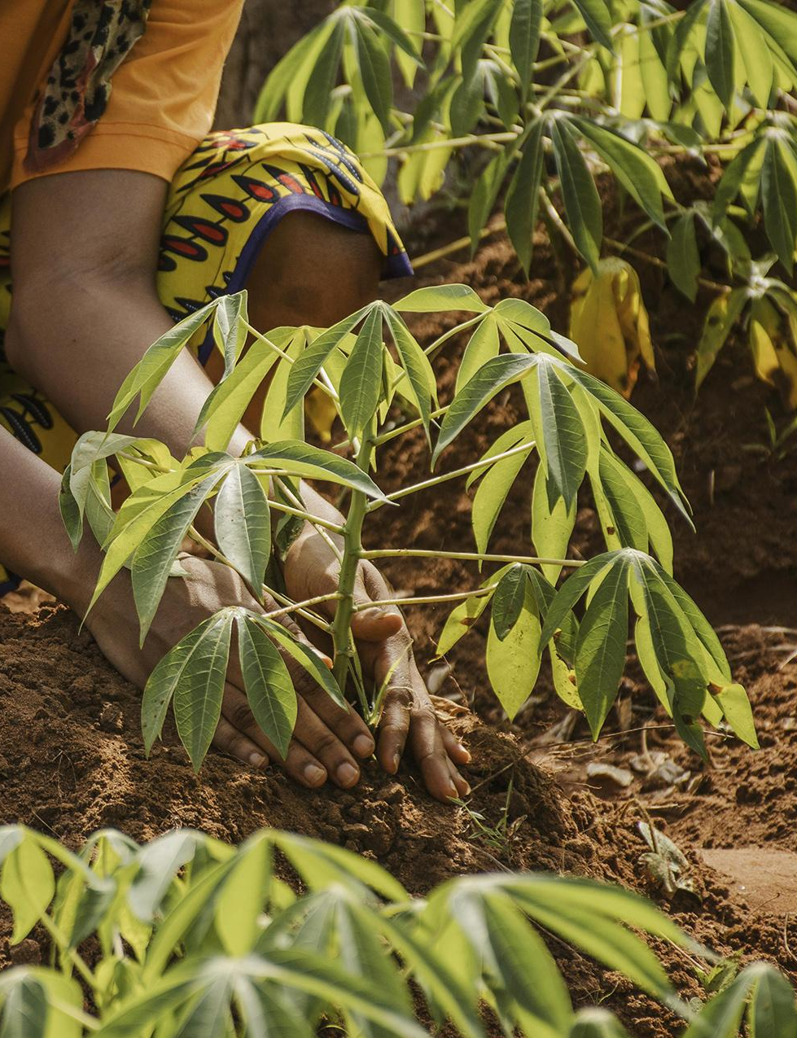
ESTIMATE THE CROP YIELD USING DATA ANALYTICS.
CROP-CULTIVOS
Domain: Data Science

Slide 2
Team Members
Sophia Mary R (111720102150)
Subhasree M (111720102153)
Vaishnavi Wagh (111720102166)
Shivani S P (111720102145)
Vidhya Bharathi R (111720102173)

Slide 3
Table of contents
01
02
03
Introduction
Problem Statement
Abstract
04
05
06
07
System Architecture
Proposed System
Modules
Literature Survey

Slide 4
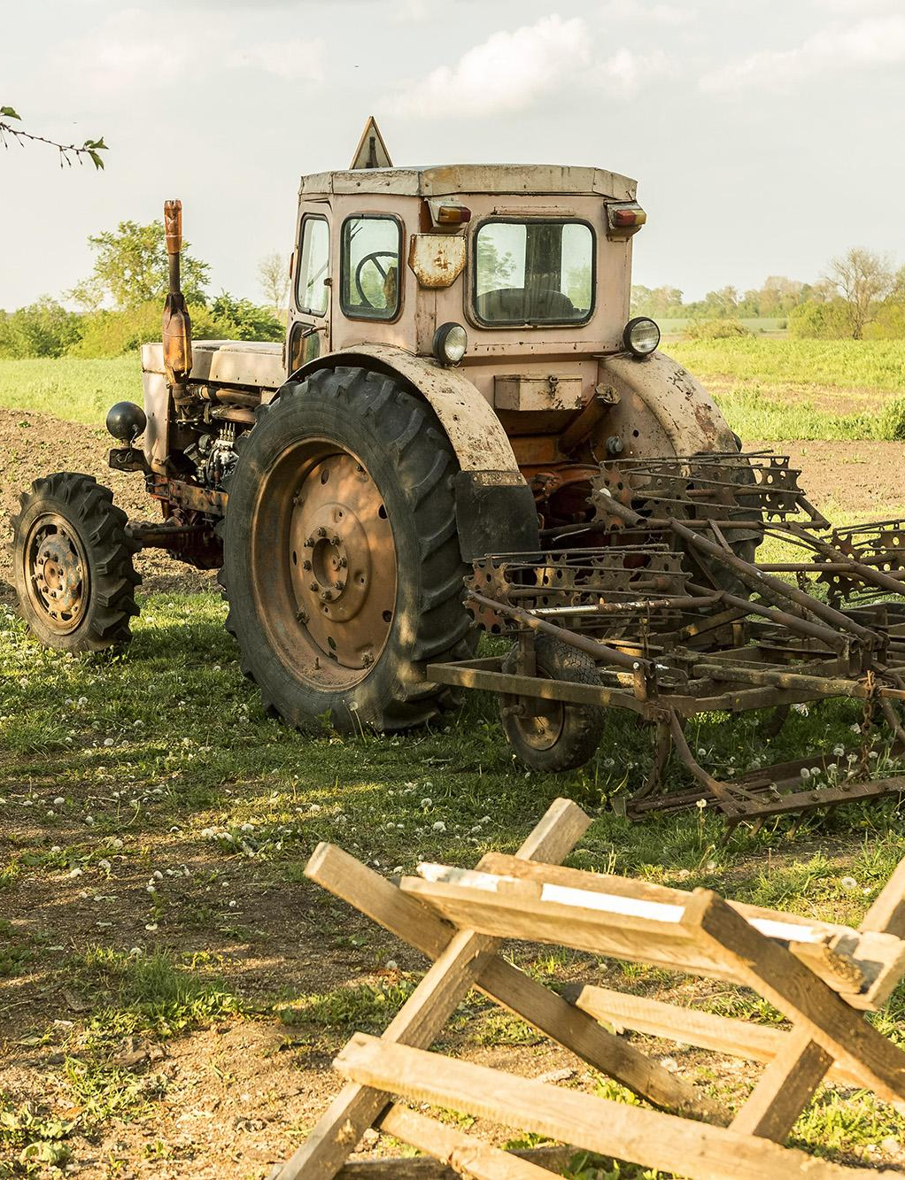
01
Introduction

Slide 5

Agriculture plays a crucial role in feeding the growing global population. Precise estimation of crop yield is the need of the hour for optimizing resource allocation, making informed decisions, and ensuring food security. Traditional methods of estimating crop yield often rely on manual measurements, historical data, and subjective assessments. Leveraging data analytics techniques can provide more accurate and timely predictions, leading to improved agricultural practices and better yield management.

Slide 6
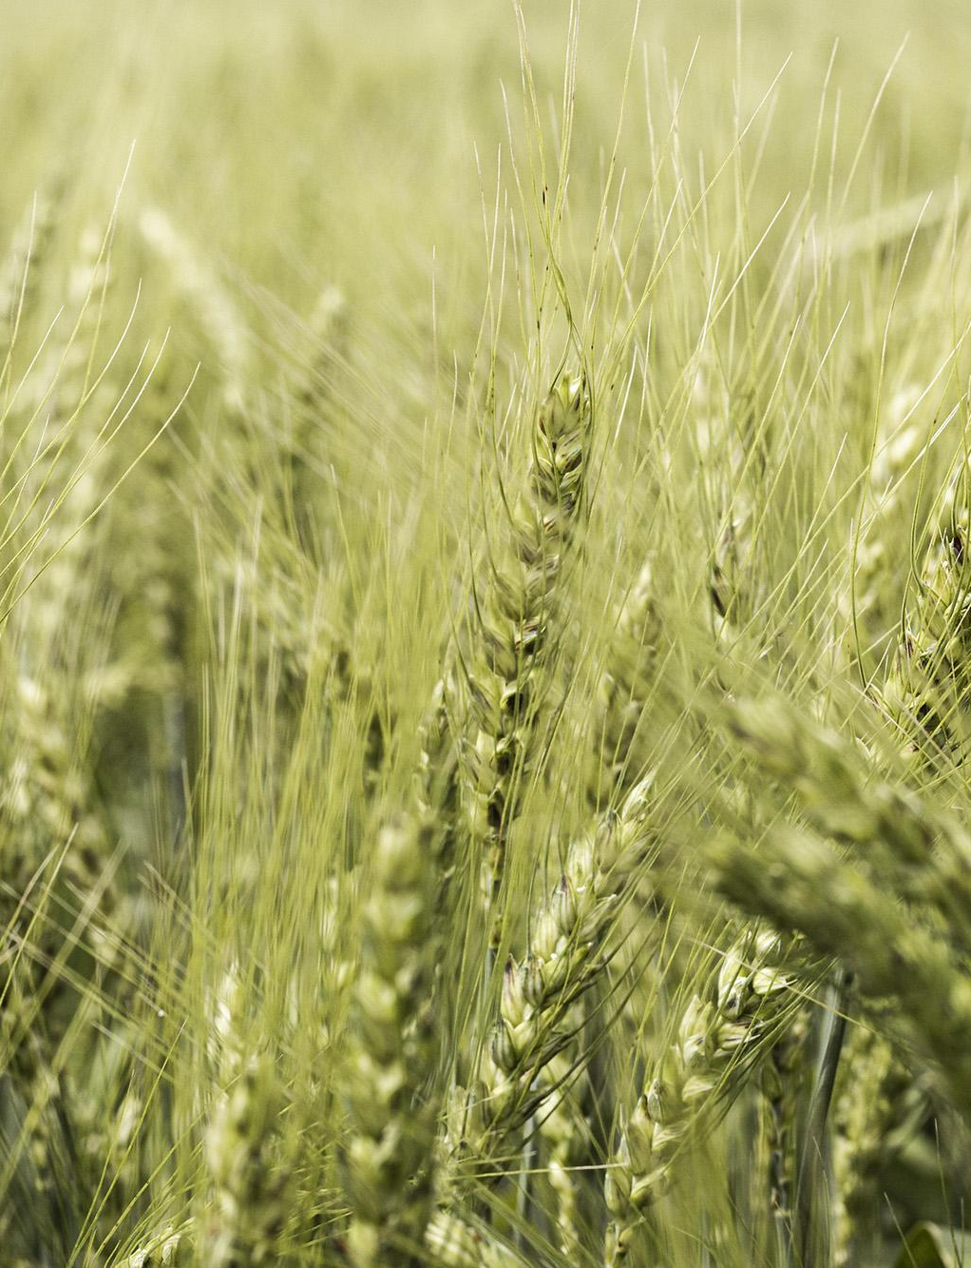
02
Problem Statement

Slide 7
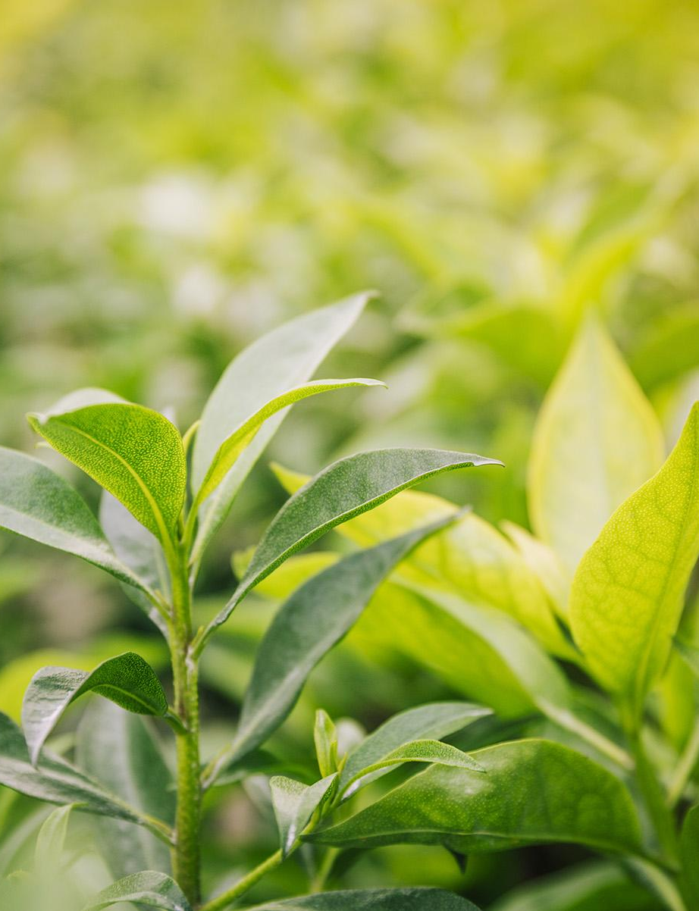
With the crop yield estimation problem in hand, there are only traditional methods which are less efficient as they are mostly done manually and often subjective. By utilizing various data sources and analytical tools, the goal is to create a predictive model that can forecast crop yield for a specific region, crop type, and growing season. The model should take into account environmental factors, historical yield data, and other relevant variables to generate reliable predictions.

Slide 8

03
Abstract

Slide 9
The rapid evolution of Information and Communication Technologies (ICT) has reverberated across the global economy, leaving no sector untouched. One profound outcome of this digital revolution is the rise of Digital Agriculture, catalyzed by the democratization of digital tools and breakthroughs in artificial intelligence and data science. Digital Agriculture has introduced novel approaches to farming that enhance productivity and efficiency while upholding environmental sustainability. Advanced digital devices and data science capabilities have enabled the aggregation and analysis of vast agricultural datasets, providing valuable insights for farmers, agronomists, and agricultural professionals.

Slide 10
This project attempts to provide a systematic review of data mining techniques in the context of Digital Agriculture, focusing on crop yield management and monitoring. It delves into the primary categories of data mining techniques used for crop yield monitoring, followed by an exploration of existing research employing data analytics in this domain. Additionally, the paper discusses the far-reaching implications of big data on agriculture, emphasizing its potential to revolutionize traditional farming practices and usher in more sustainable and efficient approaches. In a world where agriculture plays a pivotal role, harnessing the power of data and digital technologies is essential for the future of food production.

Slide 11

04
System Architecture

Slide 12
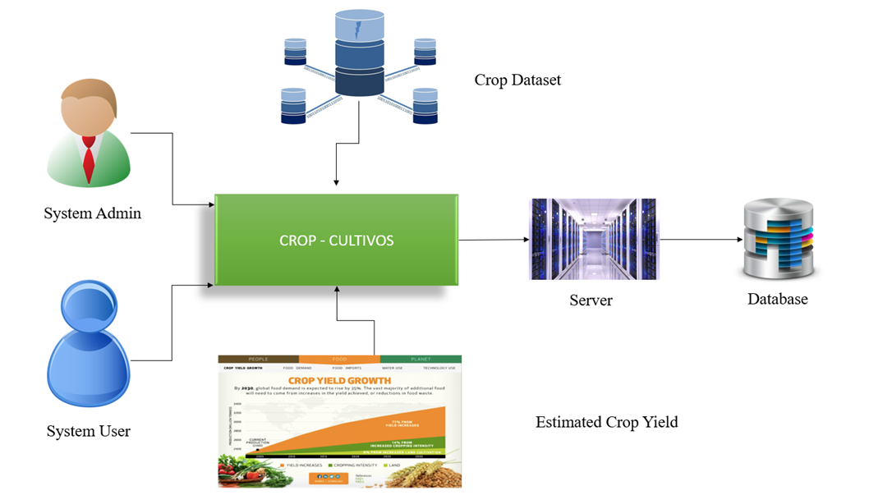

Slide 13
05
Proposed System

Slide 14
Advantages of Proposed System
Adaptation to climate change
Risk mitigation
Data-driven decision making
Crop growth modelling

Slide 15
06
Modules

Slide 16
1. Geographical Region Assessment
2. Precipitation and Climate Analysis
3. Agricultural Input Evaluation

Slide 17
07
Literature Survey

Slide 18
1. Accelerating Crop Yield: Multisensor Data Fusion and Machine Learning for Agriculture Text Classification
______________________________________________________________________________________________
Authors: A. REYANA, SANDEEP KAUTISH, P. M. SHARAN KARTHIK, IBRAHIM AHMED AL-BALTAH, MUHAMMED BASHEER JASSER, (Member, IEEE), ALI WAGDY MOHAMED
Algorithms Used:
Random Forest
Hoeffding Tree
Decision Tree
The Random Forest and Hoeffding Tree algorithms have exhibited lower error rates when applied to the data categorized by zone and variety. However, it is evident that the machine learning model's performance falls short of expectations.

Slide 19
2. A Comprehensive Review of Crop Yield Prediction Using Machine Learning Approaches With Special Emphasis on Palm Oil Yield Prediction
______________________________________________________________________________________________
Authors: MAMUNUR RASHID, BIFTA SAMA BARI, YUSRI YUSUP, MOHAMAD ANUAR KAMARUDDIN, NUZHAT KHAN
Features taken into consideration:
1. Leaf and fruit info
2. Irrigation, climate, groundwater info
3. Historical yield, cropland info
4. Soil, vegetation data
Algorithms Assessed:
ANN 4. MARS 7. CNN
DTT 5. SVM 8. LSTM
RF 6. DNN

Slide 20
Challenges Faced:
Addressing the challenges encountered in this research was a complex endeavor. One of the foremost hurdles was the absence of a standardized combination of features, making it difficult to establish a consistent framework. Selecting an appropriate prediction algorithm posed another significant challenge, as the variety of options available required careful consideration.
From a research perspective, remote sensing presented reliability issues that needed to be carefully managed and mitigated. Understanding the diseases affecting the plantation and their broader impacts proved to be a particularly intricate task, demanding innovative approaches and comprehensive data.

Slide 21
Challenges Faced:
Nutrient content emerged as a pivotal factor influencing crop yield, yet estimating it accurately posed a formidable challenge. Climate change had an undeniable and profound impact on crop cultivation, introducing an additional layer of complexity and uncertainty to the research.
While the Internet of Things (IoT) offered promising prospects for predicting crop yield, it was not without its own set of challenges. Notably, labor deficiency hindered the effective implementation of IoT solutions, necessitating creative solutions and strategies to overcome this limitation.
Ultimately, the research faced the recurring dilemma of selecting the optimal feature set and algorithm, highlighting the need for rigorous evaluation and experimentation in order to arrive at sound conclusions and insights. In navigating these challenges, the research not only advanced our understanding of crop yield prediction but also underscored the importance of adaptability and innovation in agricultural research and practice.

Slide 22
3. Crop Prediction Based on Characteristics of the Agricultural Environment Using Various Feature Selection Techniques and Classifiers
______________________________________________________________________________________________
Authors: S. P. RAJA, BARBARA SAWICKA, ZORAN STAMENKOVIC, (Senior Member, IEEE),
G. MARIAMMAL
Feature Selection Techniques involved:
Boruta: Boruta is a Random Forest Classification algorithm used to identify the most relevant and informative features in a dataset for a particular predictive task.
RFE: Recursive Feature Elimination comes under the classification of Wrapper feature selection techniques to discover the dataset’s salient features.
MRFE: Modified Recursive Feature Elimination removes non-salient features from the dataset.

Slide 23
Classification Techniques used:
Naive Bayes
Decision Trees
Support Vector Machines (SVM)
K-Nearest Neighbours (KNN)
Bagging (Bootstrap Aggregation)
Random Forest

Slide 24
4. Predicting Agriculture Yields Based on Machine Learning using Regression and
Deep Learning
______________________________________________________________________________________________
Authors: PRIYANKA SHARMA, PANKAJ DADHEECH(Member, IEEE), NAGENDER ANEJA, SANDHYA ANEJA (Member, IEEE)
Methods Implemented:
K Fold Cross Validation
Decision Tree
Random Forest
XGBoost
Convolutional Neural Networks
Data Set Segregation:
70% training data (K fold cross validation)
30% test data

Slide 25
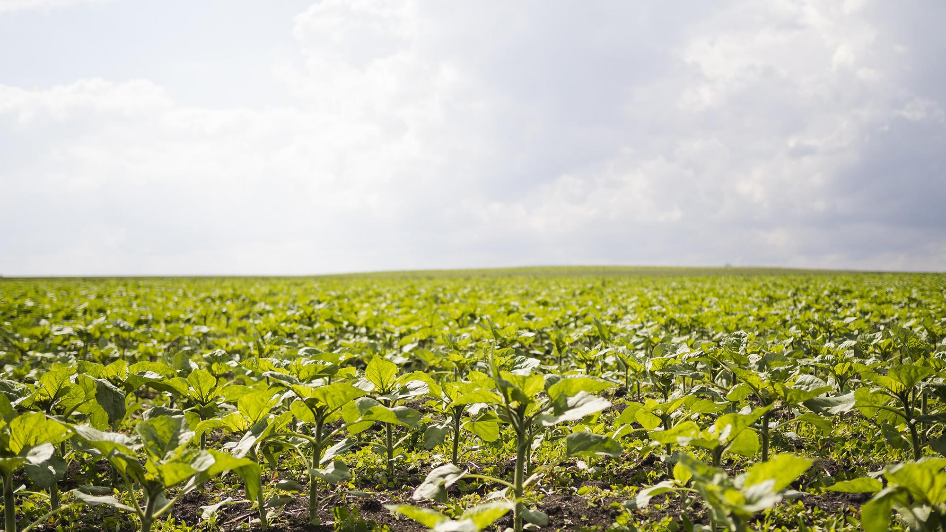
Agriculture is the most healthful, most useful, and most noble employment of man.
George Washington

